Slide 1
More Eyes Master Slide Deck
Ryan Paterson, Deputy Director, AEO
December 2010

Slide 2
Contents
Background
Vision and Objectives
Enterprise Architecture
Data Capture
Data Integration/Analysis
Data Visualization/Presentation
Schedule

Slide 3
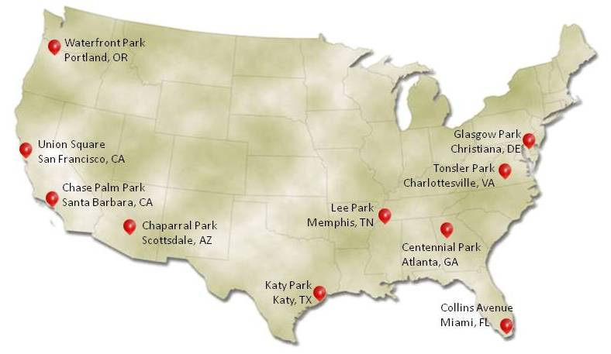
Network Challenge: Crowd sourced data-streams can outperform traditional information assets
Purpose: Research mobilization, self-organization potential of social networks & crowd sourcing
Challenge: Locate 10 large, red weather balloons at undisclosed locations across the United States on Saturday, December 5 2009
Result: All 10 balloons located in 8 hours 52 minutes
⬥ Winner = MIT Red Balloon Challenge Team (pyramid scheme)
⬥ 4,368 total registrants
⬥ Widespread positive news coverage
NY Times, WSJ, Washington Post, CNN, MSNBC, ABC, etc.
Implication: Civil Defense & National Security
Union Square,
San Francisco
Balloon Locations/Time First Submitted
12:56
*Balloons Went Up at 10:00 EST*
10:08
12:14
_{Data Analysis Pending:}
Meet with teams to review the approaches and strategies used to build networks, collect information, and participate in the Challenge.
_{Web traffic analysis.}
_{Social networking analysis.}
13:01
11:54
11:11
11:32
11:27
14:20
15:57

Slide 4
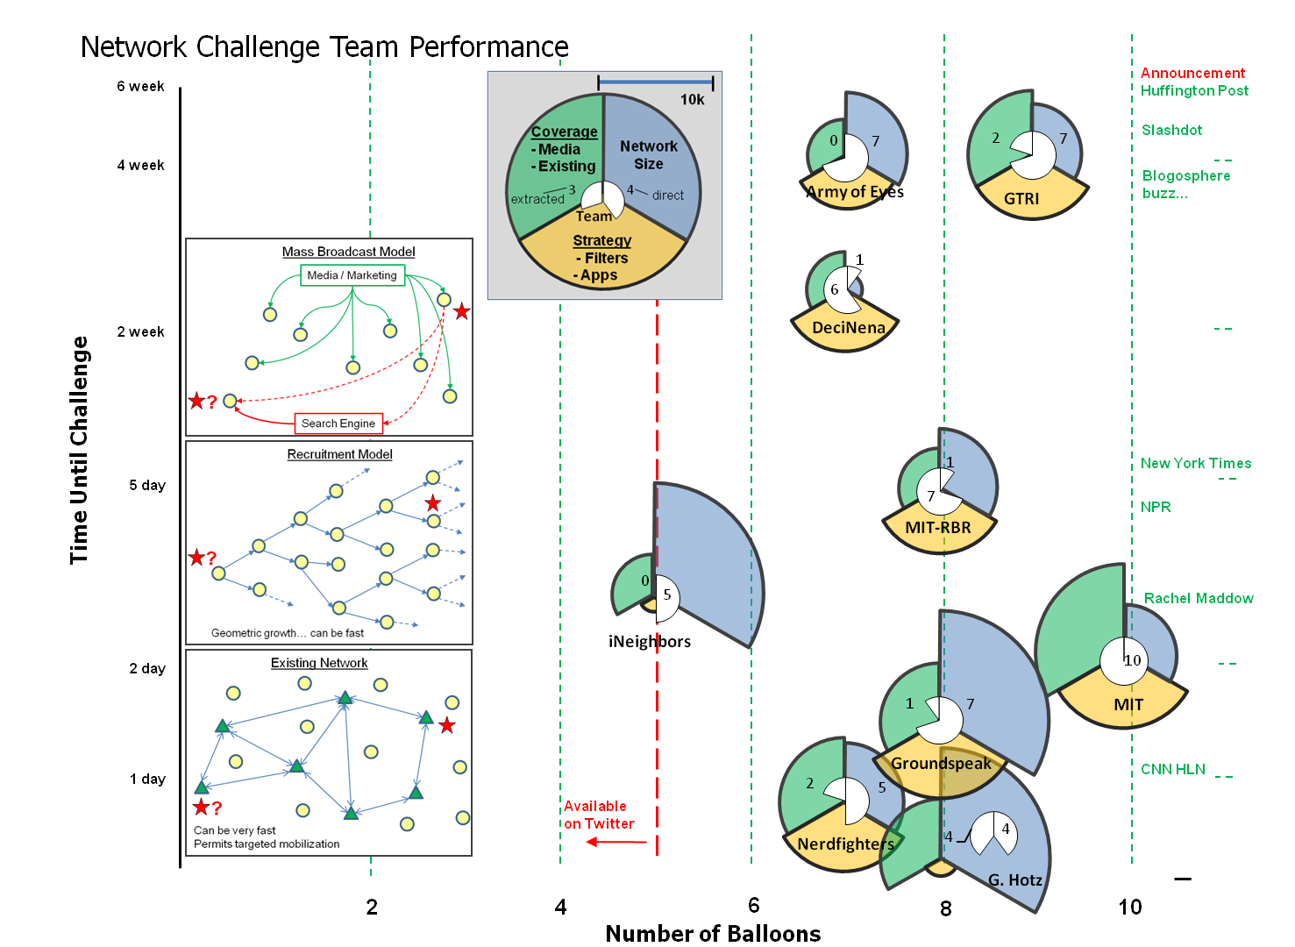

Slide 5
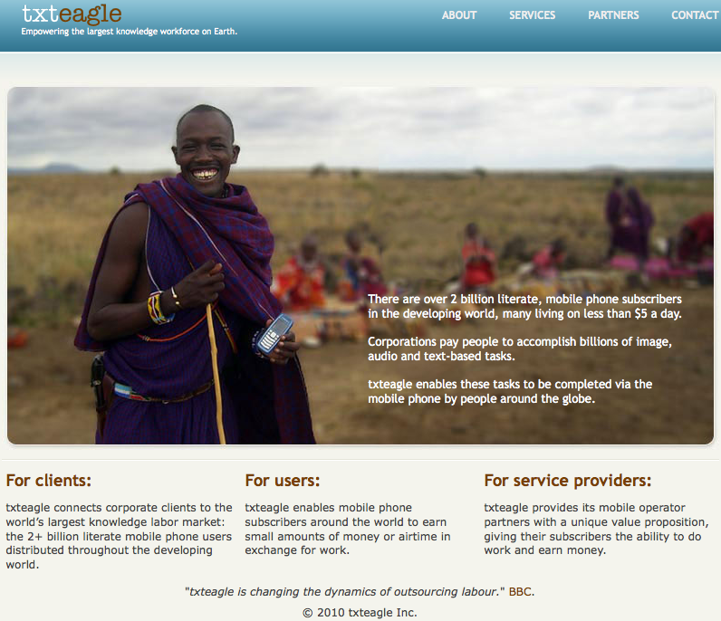
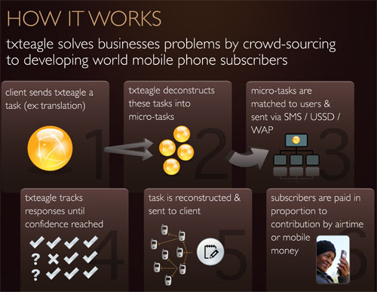
Properly structured incentives and incentive delivery mechanism can create information and product flow
How it works: Tasks (surveys, voice recordings, GPS tags, texts, etc.) are parsed into micro tasks and distributed to mobile phone users
Compensation: mobile phone minutes or “mobile money” – mobile payment center located in most villages in Kenya
Human-in-the-Loop Services
Image Tagging
Video Tagging
Speech Corpus
Text Sentiment Analysis
Outsourcing Services
Image Transcription
Translation
Software Localization
Audio Transcription
Internet Search
Internet Activities
Software Beta Testing
Local Information Services
Health Surveys/Government populace surveys
Market Research Surveys
Focus Groups

Slide 6
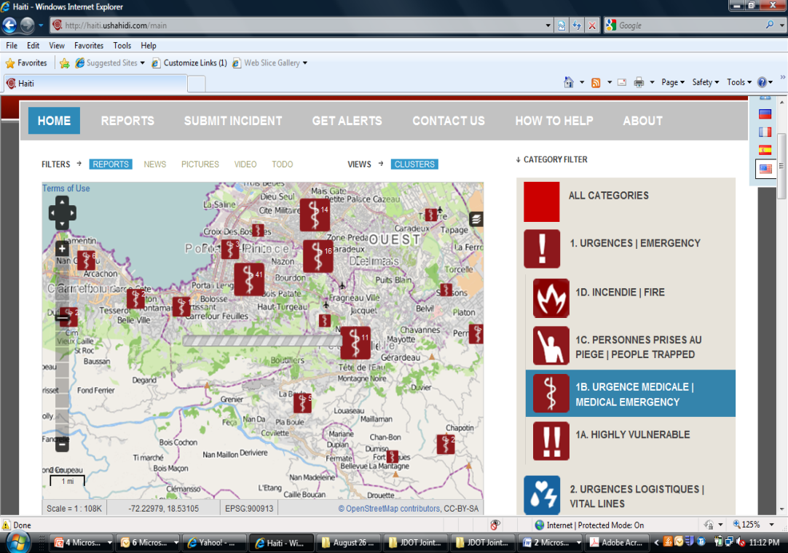
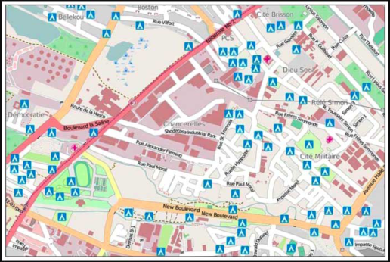
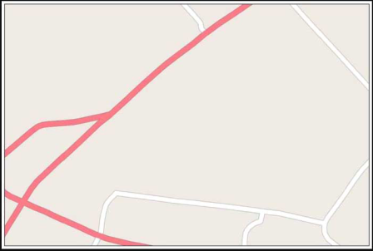
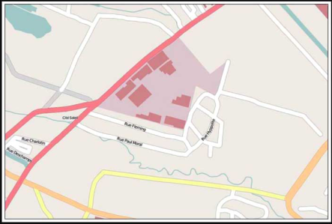
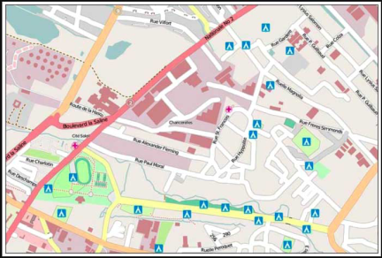
Sharing and easy access of integrated data promotes digestion and addition of data
The Ushahidi Platform allows anyone to gather distributed data via SMS, email or web and visualize it on a map or timeline.
Open access allowed the following:
Ad Hoc 911 service
Price gouging reports
Internet access locations
“Menaces”
Infrastructure damage
Services available
6 Jan (day -6)
13 Jan (day +1)
15 Jan (day +3)
30 Jan (day +18)
Building Maps of Port Au Prince as a starting place

Slide 7
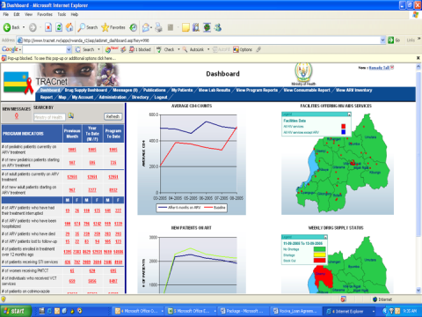
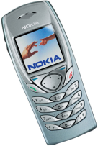
More Eyes Vision and Implementation
Vision: Increase the speed and effectiveness of information collection through the use of novel crowd sourcing techniques. Combine crowd sourced information with existing information in order to provide a collaborative visualization and analytical interface to better understand regional stability in Afghanistan.
Catalyze real-time, outside the wire, white data collection and data dissemination
Assimilate real time and latent data streams into a common dataset
Create a graphical user interface for quasi-static datasets and high volume real-time
_{Implementation:}
_{More Eyes}
_{Data Capture}
_{More Eyes}
_{Assimilated Data Repository}
Graphical User Interface and toolset for stability indicators
_{Smart-Phone Web Page}
_{Smart Phone App}
_{SMS Text}
_{SMS Text}
_{AIDC}
_{DSF}
_{Malomat}
_{Web Page}
_{Crowd Source Database}
_{PIMMS}
_{Afghan Info}

Slide 8
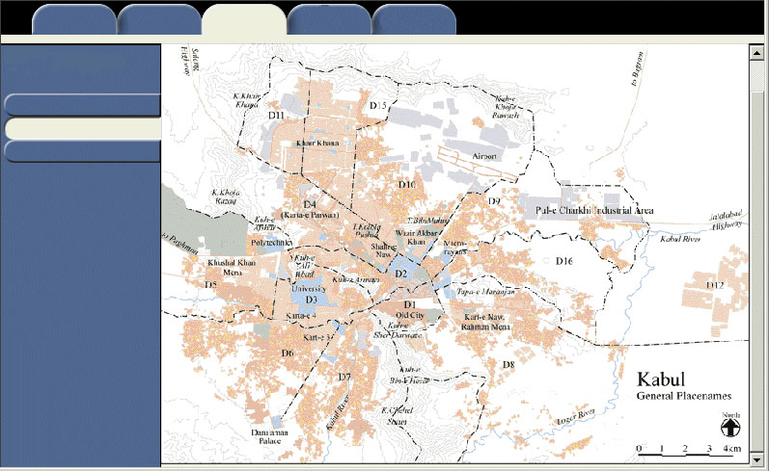
Catalyze an Afghan Specific, Easily Accessible Open Data Forum
Goal: Catalyze a public information forum that is useful for the local populace to increase safety, aid commerce, provide real time information for humanitarian assistance and development related activities.
Distribution: Facilitated viral distribution of application or web presence.
Challenge: Must be useful for user population or voluntary reporting construct will fail.
Reporting Tools:
Smart Phone Apps
Smart Phone Web Pages
Traditional Web Page
SMS Text
_{Travel}
_{Medical}
_{Clinics}
_{Markets}
_{Polling Stations}
_{Location History}
_{Report Conditions}
Commerce Conditions:
Physical road conditions – bridges, passes, tunnels passable
Checkpoints
Safety
Market conditions – open/closed
Estimated transit time
Gas/food/lodging
Open forum for queries
Location history (1 week or month)
_{Operating Hours}
_{Price per goods}
_{Safety}
Provide a forum where a community can help themselves by increasing awareness
_{11/01/10}
Distribution authorized to U.S. Department of Defense and U.S. DoD contractors only (Critical Technology) 21 Jan 2010. Other requests shall be referred to DARPA Technical Information Office.

Slide 9
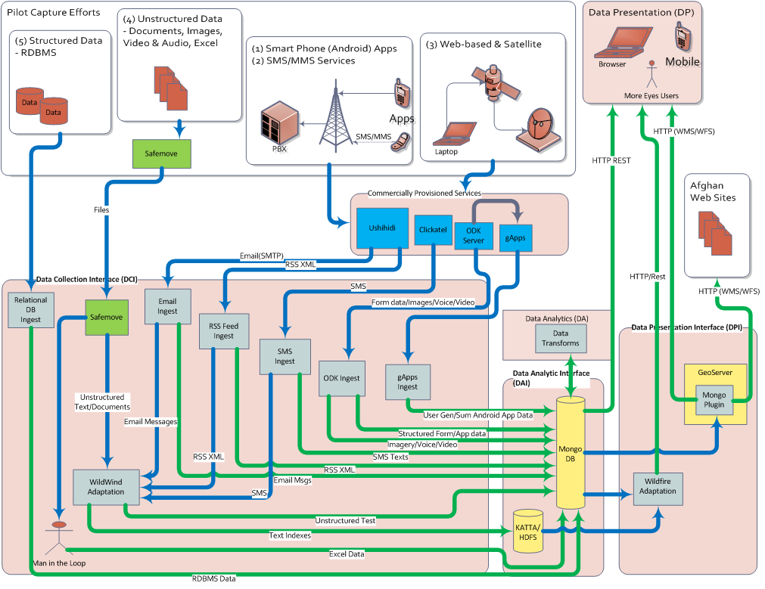
Data Integration/Analytics SW Architecture

Slide 10
More Eyes Pilots: Overall Strategy
Pilot Selection Criteria:
Provide Value to Afghan Population
Leverage Existing Networks
Potential for Viral Growth
Provide Value to Stability Operations
Map the Afghan Network Terrain
Map the Afghan Human Terrain
Test Viability of Different Network Technologies
Test Incentive Structures
Afghanistan
Jalalabad
Nangarhar
Province
More Eyes Pilots
Pahjwok News Service
DIA Atmospherics
Free & Fair Election Foundation
International Relief & Development
Nangarhar University: Agribusiness
Connect Jalalabad
Jalalabad Clinics
Nangarhar Midwives
1
5
2
6
3
7
4
8
NOV | DEC | JAN | FEB | MAR | APR
1
2
3
4
5
6
7
8

Slide 11
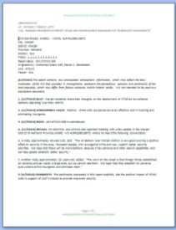
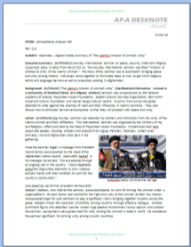
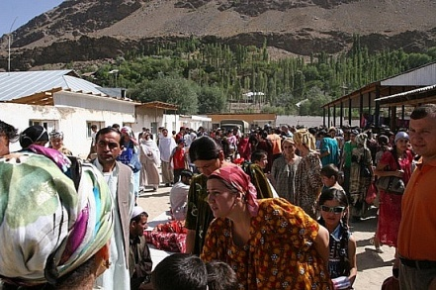
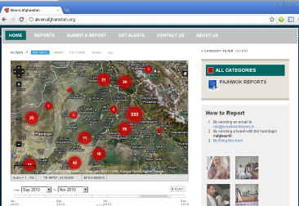
Atmospheric Program – Afghanistan (AP-A) Pilot Information Flow Diagram
ASCs
REPORTS
ANALYSIS
AP-A
TEAM
Universities
ODK
PUBLIC
WEBSITE
Mosques
MORE EYES
FIREWALL
FILTER
ME
Repository
DIA
Atmospherics
Improved volume, accuracy, consistency, & timeliness of raw reporting
AP-A data input to More Eyes data repository enables analytics
Pathfinder for host nation individuals aptitude with smart apps

Slide 12
Atmospheric Program – Afghanistan (AP-A) Pilot Overview
DARPA Objective: Implement a cell phone reporting process to facilitate reporting, translation, and integration of atmospheric data
Description of current process:
Afghan Subcontractors (ASC) passively collect targeted atmospheric data during the course of everyday life
ASCs report to DIA teams consisting of Afghan-Americans (AA) and US Military Analysts (MA)
The AA translates and formats the report. The MA integrates reports and submits to SOIC
Scale and Schedule:
Work with AP-A to develop Open Data Kit (ODK) reporting interface (forms)
Implement ODK interface structure on Google Apps Server
Install ODK reporting interface on 20 Android local phones (Sony X10 Mini Pro). Provide phones to AP-A to distribute to select ASCs by 20 November 2010. Goal is to expand to 200+ phones nationwide
Train AP-A analysts to use ODK
AP-A forwards appropriate information to More Eyes repository for integration and visualization in support of stability operations
Issues:
Translation
Public facing of information
Security for ASCs using smart phones

Slide 13
Atmospheric Program – Afghanistan (AP-A) Pilot Schedule
Data Capture Interface (DCI) and
As soon as possible
DFC coordination with DAI leadership about scope of AP-A pilot
Explore Dari language capability on Android platform
Explore remote wipe access for phones
Nov 3
White board session with AP personnel to help design interface of survey system for Afghan Sub Contractors (ASCs)
Develop desired survey interface based on input from AP-A
Nov 7-9
DFC receives 20 Android local phone (Sony X10 Mini Pro), configured with interface, and tested (1 day planned)
Nov 9-11
Deliver phones to AP-A and train AP-A team to use phones for tasks with ASCs
On going
Monitor and track any issues occurring with phones in the field

Slide 14
International Relief & Development Pilot
Streamline IRD reporting
Leverage existing IRD social networks
Expand content through viral networking
AIDC
Internet Cafe
Picture here
IRD Social Network
ME
Repository
MORE EYES
SMS
PUBLIC
WEBSITE
ODK
USHAHIDI

Slide 15
IRD Engineer Pilot Overview
DARPA Objective: Use smart phone applications to facilitate IRD Engineer reporting. Leverage IRD Engineer field contacts to expand reporting networks
Description of current process:
IRD Engineers conduct field surveys of infrastructure projects funded by USAID and other donors using WiFi-capable phones
When internet access is available, Engineers upload their reports (text and photos) to the AIDC database
Scale and Schedule:
Develop smart phone forms to facilitate near real-time engineer reporting via ODK by December 2010
Provide 30 smart phones with ODK collection apps to IRD for distribution to field engineers by January 2011
Data/information is automatically sent to More Eyes repository for integration and visualization in support of stability planners and Afghan population
Issues:
Security for Engineers using smart phones in rural areas

Slide 16
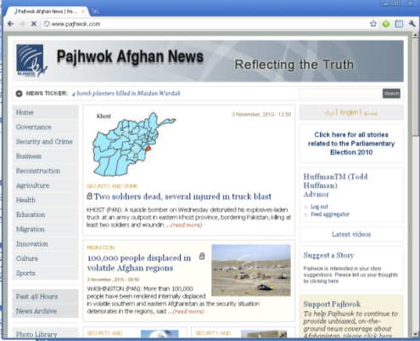
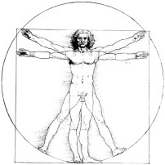
Pajhwok News Pilot
AFFILIATES
PAJHWOK WEBSITE
& WIRE
FM Radio
Newspapers
Afghan Public
PAJHWOK
SERVERS
ME
Repository
MORE EYES
EMAIL
WEB
PAJHWOK
REPORTERS
Citizen Reporting
SMS
Visualization for Stability Planning

Slide 17
Pajhwok News Service Pilot Overview
DARPA Objective: Implement a process to enhance and expand SMS and web based “citizen reporting”
Description of current process:
Individuals can “Suggest a Story” on the Pajhwok web page
Individuals can “Submit a Report” on the Alive in Afghanistan web page
Scale and Schedule:
Assist Pajhwok to expand SMS reporting by providing incentive support to “citizen reporters” starting in January 2011
Supply Pajhwok with an SMS server with large capacity by December 2010
SMS reports sent to More Eyes repository for integration, processing and visualization in support of stability operations
Leverages existing cell phones of the local population. No smart phones will be delivered
Issues:
Maintenance of access to raw reporting data

Slide 18
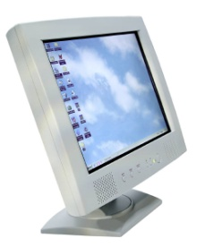
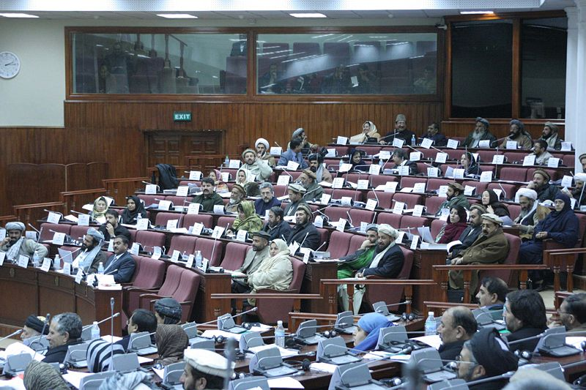
FEFA Pilot
Help Afghan population track how FEFA Parliament votes in their elections
Parliamentary operations can be used for stability operations
SMS
ODK
FEFA Monitors
USHAHIDI
Visualization for Stability Planning
ME
Repository
MORE EYES
Parliament
FEFA Web
Server
FEFA PUBLIC
WEBSITE

Slide 19
FEFA Pilot Overview
DARPA Objective: Create a mechanism for recording Afghan Parliament proceedings in more detail. Make this information available for public access via a web interface and to stability planners through MORE EYES repository
Description of current process:
Currently, records of Parliamentary proceedings only include vote counts, but very little else
Scale and Schedule:
Provide Parliament monitors with 20+ smart phones loaded with appropriate apps by January 2011
Commence posting information in near real time on parliamentary debates and voting records by January 2011
Display expanded parliamentary data on FEFA web interface
Issues:
Potential consequences of increased transparency

Slide 20
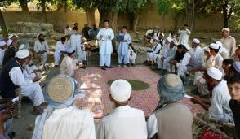
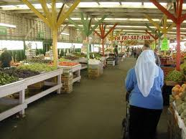
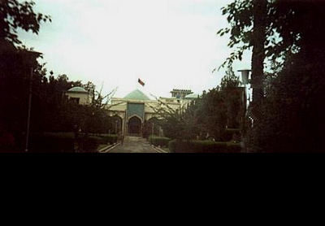
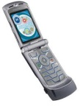
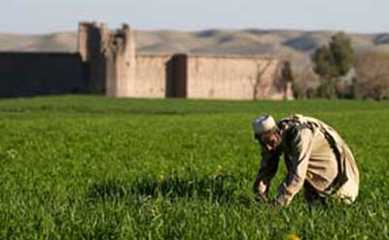
Nangarhar University Agribusiness Pilot
USHAHIDI
Smartphone App
Web
Server
Use NU Agriculture Department students/faculty network to report on development in rural areas
Provides benefit to regional agribusiness community and informs stability operations
Regional Agribusiness Community
USHAHIDI
SMS
ME
Repository
MORE EYES
Nangarhar University
Visualization for Stability Planning
USHAHIDI
SMS

Slide 21
Nangarhar University Agribusiness Pilot Overview
DARPA Objective: Implement a cell phone reporting process to facilitate reporting of local agribusiness conditions collected by Agriculture Department researchers and students in the Agriculture Department
Description of current process:
Nangarhar University Agriculture Department researchers and students travel to rural areas to observe, record and report on agribusiness conditions
Researchers/students report conditions upon their return to the University
Scale and Schedule:
Distribute ~100 smart phones with apps to facilitate researcher/student reporting via Ushahidi by 31 January 2011
Train 1000+ student body on SMS inputs by 28 February 2011
Data/information is automatically sent to More Eyes repository for integration and visualization in support of Nangarhar University research development, regional agribusiness community, and GIRoA/ISAF stability operations
Issues:
Security for students/researchers using smart phones in rural areas
Enable users to develop their own ODK apps

Slide 22
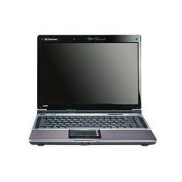
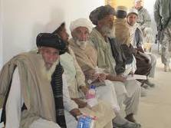
Jalalabad Clinics Pilot
ME
Repository
MORE EYES
WEB
Visualization for Stability Planning
EMAIL
AUDIO
CLINIC
WEBSITE
As patients wait for medical services in clinics, they can use the internet for free
They fill out a simple form asking for targeted information

Slide 23
Jalalabad Clinics Pilot Overview
DARPA Objective: Gather data from persons waiting to be seen
Description of current process:
There is currently no process for gathering data from medical clinic patients
Scale and Schedule:
Commencing in February 2011, install 50 web-connected computers in the waiting rooms of selected clinics
As patients wait for medical services, they can use the internet for free, provided they fill out a simple form asking for targeted information
Forms can be changed quickly based on emerging information needs
Issues:
WWW Network connectivity

Slide 24
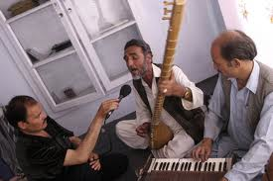
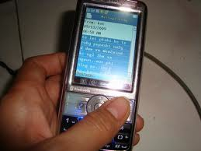
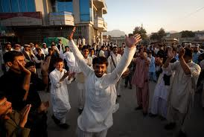
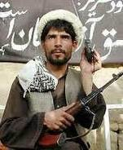
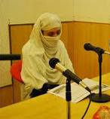
Connect Jalalabad Pilot
2. Contest submissions via SMS
3. Radio station broadcasts submissions and public votes via SMS
4. Radio station announces winner
SMS
ME
Repository
1. Radio station announces contest
ODK
SMS
SMS
MORE EYES
Leverage the radio station reach to facilitate a ‘self-reporting’ inventory of SMS capable phones in Nangarhar Province through a serialized, radio broadcast, “American Idol”-like contest.
Visualization for Stability Planning
PUBLIC WEBSITE

Slide 25
Connect Jalalabad Pilot
2
1
2. Contest, data calls, etc. submissions via SMS
1. Radio station announces contest, data calls, etc.
Data Collection
Data Publish
Data Validation
Data Call
Incentive!
SMS
ME
Repository
3
3. Radio station broadcasts submissions
MORE EYES
5
5. Radio station announces winner, grand prize, free cell minutes, etc.
4
4. Crowdsourced validation via SMS voting
SMS

Slide 26
Connect Jalalabad Overview
DARPA Objective: Implement a cell phone reporting process to inventory rural SMS cellphone users within Nangarhar province and to test the utility of a winner-takes-all incentive structure
Description of current environment:
Transistor radios are estimated to be in 90% of rural households within Nangarhar Province
SMS capable cellphones are estimated to be in 65% to 75% of target households
Poetry is a culturally authentic and SMS capable mechanism to instill a sense of competition amongst rural participants
While the submission of poetry compositions requires a minimum level of literacy, voting on submissions via SMS requires virtually no literacy
Scale and Schedule:
Partner with a local radio station to organize, advertise, and execute a serialized, radio broadcast, “American Idol”-like contest in February 2011
Implement SMS server
Cull SMS data stream to inventory and geotag SMS users in target area
Submit SMS survey to elicit demographic data from competitors
Issues
Teaming negotiations
Translation/Illiteracy support
Incentive structure for demographic data elicitation

Slide 27
Connect Jalalabad Pilot – Timeline
Identify Partners: as soon as possible (Nov 8,9)
Leverage local relationships of Todd and Dave to ‘sell’ pilot to local radio
Identify/Negotiate incentives, prize structure, and timeline
Ensure SMS data collection capability
Validate Assumptions
Complete Pilot Preparations: Dec 1-15
Write scripts, demographic survey, etc.
Test SMS push in Nangarhar
Jan 7-22
Commence Contest
Confirm collection of data
On going
Monitor and track any issues occurring with phones in the field
Capitalize on serendipitous opportunities
Cull demographic data to support the follow on Midwife Pilot

Slide 28
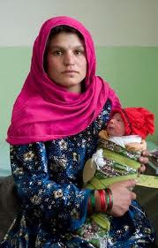
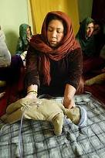
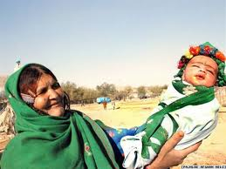
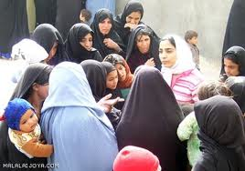
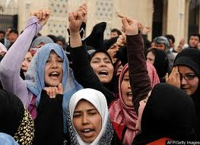
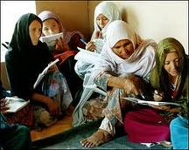
Nangarhar Midwife Pilot
Implement a cell phone/SMS chat network to link women to a network of urban care providers and rural midwives.
Test illiteracy mitigation techniques.
SMS/ODK
Server
MORE EYES
ME
Repository
Visualization for Stability Planning
_{SMARTPHONE APP}
PUBLIC WEBSITE

Slide 29
Nangarhar Midwife Network Overview
DARPA Objective: Implement a cell phone/SMS chat network to link women (predominantly rural) to a network of urban care providers and rural midwives, thereby accessing an all female demographic group, testing ODK scalability, and experimenting with icon and ODKVoice based illiteracy mitigation strategies
Description of current environment:
Afghan cultures are paternalistic and female literacy is generally lower than male literacy
Afghan women have generally not been recruited into the insurgency but have seen their male kin fight and die
Empirical evidence suggests that as a result Afghan women have largely adopted a more uniformly ‘pro-stability’ stance than Afghan men and may therefore provide a valuable, contrasting perspective to other Pilot Program participant groups
Scale and Schedule:
Commencing March of 2011, partner with Nangarhar Medical Institutions and nearly 100 rural midwives to establish a pre/neo-natal social network
Nangarhar Province has a population of nearly 350,000 women with approximately 68,000 annual births
Implement ODK Voice interface structure on Google Apps Server
Cull SMS data stream to inventory and geotag SMS users in target area
Submit ODK survey to elicit demographic data from participants
Manage the evolution from SMS phones to smart phones
Issues
Teaming negotiations
Translation/Illiteracy support
Incentive structure for demographic data elicitation
Validate Assumptions

Slide 30
Nangarhar Midwives Pilot - Timeline
Identify Partners as soon as possible (Nov 8,9)
Validate Assumptions
Leverage local relationships of Todd and Dave to identify the local Ob/Gyn/Midwife community
Identify possible NGO partners to source and distribute SMS phones
Identify/Negotiate incentives, and timeline
Ensure SMS data collection capability
Dec 1-30
Prepare illiteracy mitigation techniques
Socialize the Pilot to the local Ob/Gyn/Midwife community
Jan 1-30
Commence distribution of ODKVoice app
Commence distribution of cell phone
Cull demographic data from Poetry Pilot to support the Midwife Pilot
On going
Confirm data capture
Monitor and track any issues occurring with phones in the field
Feb 1-28
Commence evolution of network interface/capability
Monitor user adaptation/innovation

Slide 31
Pilot Summary - Front End (1 of 2)
 | AP-A 1.1 | IRD Engineers 2.1 | Pajhwok News Service (PNS) 1.2 | FEFA 1.3
Objective | Facilitate reporting for atmospherics data | Provide the ability for IRD engineers to submit infrastructure reports to the AIDC database | Enhance the number of "citizen reports" of newsworthy items | Provide a mechanism for recording and providing public access of the details of Parliamentary proceedings
Incentive | Convenience. Efficiency. ASC can more easily file reports to DIA SOIC. Analysts can more rapidly manage ASC productivity | Convenience. Efficiency | Additional cell phone minutes. | Efficiency.
Accepting Social Network | DIA SOIC team of Afghan Self Contractors (ASC) | IRD engineers | Local Afghans who might report on events as "citizen reporters." | Afghan Parliament monitors.
Type of Data Reported | Targeted atmospheric indicators collected passively | Infrastructure data as required by USAID to monitor infrastructure projects | Location and description of newsworthy events | Debate issues, party lines, individual MP voting records, etc.
Probability of data flow | High | High | Moderate | Moderate
Relevance of data to local populace | TBD | TBD | Populace: current local news. PNS Reporters: leads. | Empowers the Afghan public to hold their legislators accountable
Relevance of data to Stability Planning Practitioners | TBD | USAID development analysts/planners | TBD | TBD

Slide 32
Pilot Summary - Front End (2 of 2)
 | Nangarhar University 1.4 | J'bad Clinics 1.5 | Connect J’bad 1.6 | Midwives 2.6
Objective | Facilitate reporting for researchers and students from Nangarhar University Agriculture Department | Provide a mechanism for local Afghans to report on targeted information while they wait for medical service | Gain Focus Area SMS phone inventory by conducting a radio contests in which people vote via cell phone | Create a midwives'-new/expectant mother social network.
Incentive | Convenience. Provides an easier way to report. | Local Afghans waiting for medical service. Incentive is free internet time. | Winner take all prize decided by SMS voting. | Improved pre/neo-natal care for network members.
Accepting Social Network | Researchers and students at Nangarhar University Agriculture Department | Local Afghans waiting for medical service | Radio audience in Nangarhar Province | New and expectant mothers in the care of local midwives and urban clinicians
Type of Data Reported | Full spectrum of agribusiness conditions | Events, attitudes, perceptions of local Afghans, etc. Flexibility to quickly address emerging information needs. | SMS inventory with Geo-tags. Demographic data from submissions. | Medical, social, and environmental data of interest to expectant mothers.
Probability of data flow | High | Moderate | High | High
Relevance of data to local populace | Moderate | High | High | High
Relevance of data to Stability Planning Practitioners | TBD | More Eyes Repository is the only destination for this data | SMS data from voting events will captured by More Eyes Repository | High

Slide 33
Pilot Summary – back end
 | AP-A | IRD Engineers | Pajhwok | FEFA | Nangarhar University | J'bad Clinics | Radio (Poetry) Contests | Midwives
Objective | Facilitate reporting for atmospherics data | Provide the ability for IRD engineers to submit infrastructure reports to the AIDC database | Enhance the number of "citizen reports" of newsworthy items | Provide a mechanism for recording and providing public access of the details of Parliamentary proceedings | Facilitate reporting for researchers and students from Nangarhar University Agriculture Department | Provide a mechanism for local Afghans to report on targeted information while they wait for medical service | Provide resources to conduct radio contests in which people vote via cell phone | Create a midwives' social network.
Data Providers and Incentive | Afghan Self Contractors (ASC), via Afghan-Americans (AA) and Military Analysts (MA) | IRD engineers | Local Afghans report on events as "citizen reporters." Incentive could be additional cell phone minutes. | Afghan Parliament monitors. | Researchers and students in the field. Provides an easier way to report. | Local Afghans waiting for medical service. Incentive is free internet time. | Individuals submit poems for competition. Incentive is a moderate prize. As individuals vote on their favorite, SMS data is collected. | Midwives, with potential expansion to other womens' interest groups.
Target Audience | DIA SOIC | USAID development analysts/planners | Reporters associated with Pajhwok News Service | General Afghanistan public | Nangarhar University Agriculture Department | DARPA More Eyes Repository is the only destination for this data | SMS data from voting events will captured by More Eyes Repository | Midwives, with potential expansion to other womens' interest groups.
Type of Data Reported | Targeted atmospheric indicators collected passively | Infrastructure data as required by USAID to monitor infrastructure projects | Location and description of newsworthy events | Debate issues, party lines, individual MP voting records, etc. | Full spectrum of agribusiness conditions | Events, attitudes, perceptions of local Afghans, etc. Flexibility to quickly address emerging information needs. | Individuals voting, location (possible), | Womens' medical issues, initially. Potential expansion to other issues of interest to women (family, security, etc.)
Number and Type of Phones | 20 Sony X10 Mini Pro (Android) for initial rollout | No additional phones required. IRD providing Android-based smart phones | No additional phones required. Afghans will use their own phones | 5 mini-pros | Native dumb phones | No phones. One computer required for each clinic selected | Voters use their own phones. No additional phones required. | TBD
Apps Needed on Phones | ODK-based forms | Infrastructure reporting forms designed by IRD | Pajhwok SMS reporting form | ODK Collect & ODK aggregate; App is straighforward and Todd will build | SMS surveys; very straighforward to build: students fill out survey on paper and then code by SMS | No phone apps needed; Web-based survey form/app very easy to build; | SMS Text capability | TBd
Servers Required and Type | Google AppEngine | None. IRD has equipment is in place. | Pajhwok server under Todd's Control and Mirrored to CONUS | Todd's server (Taj) and then to FEFA website (but we'll have access to raw feeds | University IT used but accessible by More Eyes | data captured on hosting server (could be anywhere, Taj or CONUS) | SMS server | TBD
Target Date of First Collection | TBD | TBD | Late December | TBD | Late Decemberr | TBD | TBD | TBD
Transition Strategy

Slide 34
Pilot Selection Criteria
 | AP-A | IRD | Pajhwok News | FEFA | Nangarhar Un. | J’Bad Clinics | Connect J’bad | Midwives
Leverage Existing Networks | Yes | Yes | Yes | Yes | Yes | ? | Yes | Yes
Collect Key Indicators of Stability | Yes | Yes | Yes | ? | Yes | ? | No | ?
Map the Afghan Network Terrain | ? | Yes | Yes | ? | Yes | ? | Yes | Yes
Map the Afghan Human Terrain | ? | Yes | Yes | ? | Yes | Yes | Yes | Yes
Test Viability of Different Network Technologies | Yes | Yes | Yes | ? | Yes | Yes | Yes | Yes
Test Incentive Structures | No | ? | Yes | Yes | Yes | Yes | Yes | Yes
Provide Value to Afghan Population | Yes | Yes | Yes | Yes | Yes | Yes | ? | Yes
Provide Value to Stability Operations | Yes, | Yes | Yes | Yes | Yes | Yes | Yes | ?
Potential for Viral Growth | ? | ? | Yes | ? | ? | Yes | Yes | ?
11/04/10
Notes:
1. Leverage Existing Networks: To quickly initiate the first pilots--both to rapidly acquire white data to meet other More Eyes objectives, and to act as pathfinders to inform the design of other pilots.
2. Collect Key Indicators of Stability: Develop pilots that specifically target data that provides value to the stability calculus.
3. Map the Afghan Network Terrain: Increase knowledge of who, where, and how of Afghan use of cell phone and network technology to aid in identifying pilots and projects that will provide valuable data and have the potential for viral growth.
4. Map the Afghan Human Terrain: Investigate limits and opportunities of crowd sourcing by identifying factors such as illiteracy, gender differences, tribal differences, etc., on Afghans’ ability to interact effectively with phones, smart phones, and networks. Specifically target different regions, women focused networks, etc.
5. Test Viability of Different Technologies: Smart Phones; SMS; Web access;
6. Investigate Incentive Structures: Try different approaches to incentives for reporting that will pull in valuable data, increase interest, and spark viral growth.
7. Value to Afghan Population: Provide easy access to collected data in a form that will be valuable to the Afghan people.
8. Value to Stability Operations: Provide easy access to collected data in a form that will valuable to ISAF, NGOs, and others working Afghan Stability Operations.

Slide 35
Pilot Summary - Test Characteristics
 | AP-A1.1 | IRD Engineers2.1 | Pajhwok News Service (PNS) 1.2 | FEFA1.3 | Nangarhar University1.4 | J'bad Clinics 1.5 | Connect J’bad 1.6 | Midwives2.6
Test SMS Viability | ✔ | ✖ | ✔ | ✔ | ✖ | ✔ | ✔ | ✔
Test Smart Phone Viability | ✖ | ✔ | ✖ | ✖ | ✔ | N/A | ✖ | ✖
Test Illiteracy Mitigation Strategies | ✔ | ✖ | ✖ | ✔ | ✖ | ✖ | ✔ | ✖
Target Urban Demographic | ✔ | ✖ | ✔ | ✖ | ✖ | ✔ | ✖ | ✖
Target Rural Demographic | ✖ | ✔ | ✖ | ✖ | ✔ | ✖ | ✖ | ✔
Target Females | ✖ | ✖ | ✖ | ✖ | ✖ | ✖ | ✖ | ✔
Incentive: Winner takes all | ✖ | ✖ | ✖ | ✖ | ✖ | ✖ | ✔ | ✖
Incentive: Cash Payment | ✔ | ✖ | ✖ | ✖ | ✖ | ✖ | ✖ | ✖
Incentive: Cell Time | ✖ | ✖ | ✖ | ✖ | ✖ | ✖ | ✖ | ✖
Incentive: Self Interest | ✖ | ✔ | ✔ | ✔ | ✔ | ✔ | ✔ | ✔

Slide 36
Other Sources of Data and Status
Malomat
Commodity pricing data from local markets updated on a daily basis
More Eyes has access to Malomat database
District Stability Framework (DSF)
DSF is a stability operations planning methodology
There is currently no central database for DSF data. USAID OMA is building a DSF data storage tool
More Eyes has some DSF data and will be able to access the DSF data when available
Provincial Infrastructure Management Support System (PIMSS)
Meeting with IJC POC on Friday
Afghan Infrastructure Data Center (AIDC)
Comprehensive data on USAID-funded projects, as well as civilian and military donor infrastructure projects
Acquiring from IRD
Afghan Info
Program data on USAID projects
USAID has given More Eyes the quarterly spreadsheets from 2009 to 2Q2010
ACSP

Slide 37
Data Integration/Analytics
DARPA Objective: Develop the capability to ingest, store, transform, analyze, and extract data from all the pilot efforts, USAID sources, and other sources.
Description of current environment:
USAID Data is scattered across a number of systems and stored in a variety of databases and spreadsheets.
Right now obtaining data is an entirely manual (sneaker netish) process
The pilot efforts require a process to integrate and analyze the wide range and variety of data collected including correlating with other USAID data to measure impacts and effectiveness.
Scale and Schedule:
Initial proof of concept (late Dec 2010) will focus on:
Establishing a flexible and scalable data storage architecture
Manually loading static USAID data
Implementing basic aggregation and geocoding analytics against the USAID data
Developing the core data ingestion tools to handle pilot data as it becomes available
Expose the data via HTTP REST and HTTP Web Mapping Service(WMS) and Web Feature Service (WFS) interfaces
Future Phases
Expand and refine ingestion tools and capabilities
Additional data types/sources
Develop more advanced and complex analytics including:
Free Text Analysis
Statistical Correlation between data sources
Issues:
Must handle multi-lingual data (English, Dari, Pashtu)
Data cleanliness and consistancy
Connectivity (latency and packet loss) between More-Eyes servers, pilot servers, and clients

Slide 38
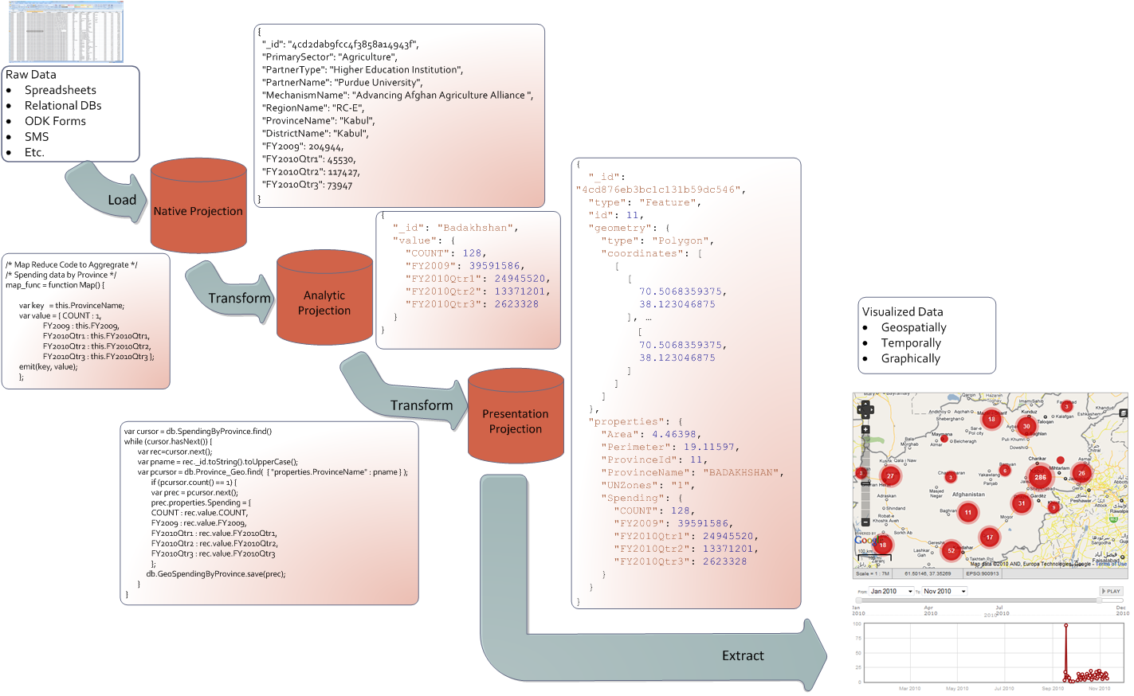
Notional Data Ingestion/Analytic Flow
Data
Code

Slide 39
Data Integration/Analytics Components (1 of 3)
Data Analytics Interface (DAI) – Provides APIs for the storage and analysis of the More Eyes Data
MongoDb – Chosen for flexibility and scalability
Document-oriented storage » JSON-style documents with dynamic schemas offer simplicity and power.
Full Index Support » Index on any attribute, just like you're used to.
Replication & High Availability » Mirror across LANs and WANs for scale and peace of mind.
Auto-Sharding » Scale horizontally without compromising functionality.
Querying » Rich, document-based queries.
Fast In-Place Updates » Atomic modifiers for contention-free performance.
Map/Reduce » Flexible aggregation and data processing.
GridFS » Store files of any size without complicating your stack.
Katta/HDFS – Distributed Lucene Indexes for unstructured text
Leverages existing DCGS-A SIPR Cloud software
Provides framework for advanced text analytics

Slide 40
Data Integration/Analytics Components (2 of 3)
Data Collection Interface (DCI) – Interfaces with the data sources provided by the pilot programs and others to capture and ingest data.
Safemove – GOTS program that will reliably monitor directories and transfer files between systems.
Relational DB Ingest – Interfaces with relational databases (PIMSS, AIDC, etc.) to retrieve data
Email Ingest – Pulls emails via POP3/IMAP to ingest as either structured or unstructured data depending on source.
RSS Feed Ingest – Interfaces with RSS feeds to ingest structured and unstructered data.
SMS Ingest – Exposes restful service to Clickatel SMS gateway to capture structured and unstructured SMS data.
ODK Ingest – Pulls structured smartphone and web application data from a Google ODK collection node. Data pulled may include imagery, voice, and video.
gApps Ingest – Uses Google Apps API to retrieve select structured document data from pilot efforts.
WildWind Adaptation – Version of the DCGS-A SIPR Cloud ingestion software adapted to use MongoDB vs Cloudbase for document artifact storage. This component is responsible for ingesting and tagging unstructured data sources.
Man in the Loop – Unfortunately this will be required to handle many of the static and legacy data sources (spreadsheets). Much of this data needs to be normalized and in many cases cleaned up in order to be loaded.

Slide 41
Data Integration/Analytics Components (3 of 3)
Data Presentation Interface (DCI) – Provides web based services for presentation applications to query data from the data store.
GeoServer with Mongo Plugin - Serves geospatially oriented data to presentation applications and other web sites.
GeoServer is the open source reference implementation of the Open Geospatial Consortium (OGC) Web Feature Service (WFS) and Web Coverage Service (WCS) standards, as well as a high performance certified compliant Web Map Service (WMS).
The MongoPlugin will allow geoserver to serve GeoJSON standard formated data from the Mongo database as WFS and WMS compliant feeds.
Can also provide base maps
Wildfire Adaptation – Provides restful APIs to allow presentation tools to perform textual, geospatial, and temporal queries against unstructured data sources.
Adaptation of DCGS-A SIPR Cloud component which will query the Katta Lucene indexes and retrieve documents from the MongDB data store.
Data Analysis (DA) – Software components which transform, aggregate and analyze data within the MongoDB data store.
Three core types:
Basic Transforms (e.g. from spreadsheet to GeoJSON format)
Aggregation/Summarization via Map/Reduce
Integration – merge data from two sets (e.g. map/reduce results as properties into a GeoJSON set of province boundaries)
Mostly developed in Javascript
Supports rapid prototyping
Serverside execution within MongoDB

Slide 42
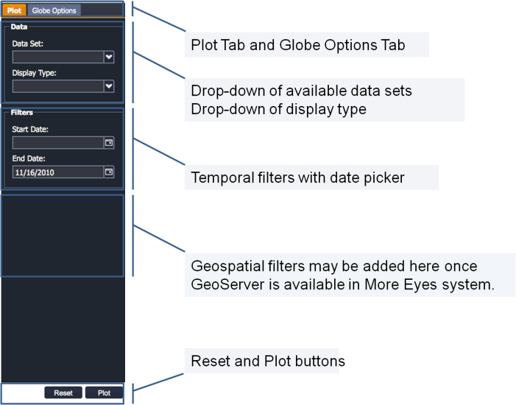
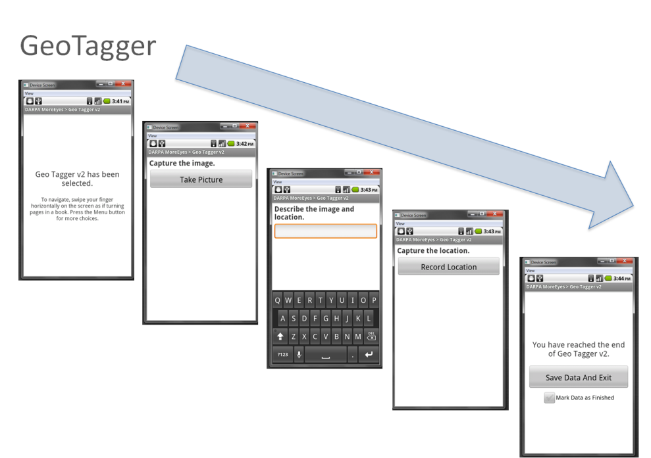
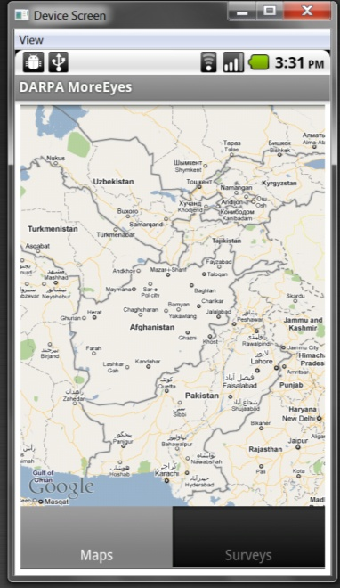
Data Visualization/Presentation
IN PROGRESS

Slide 43
High-level plan

